Slide 1
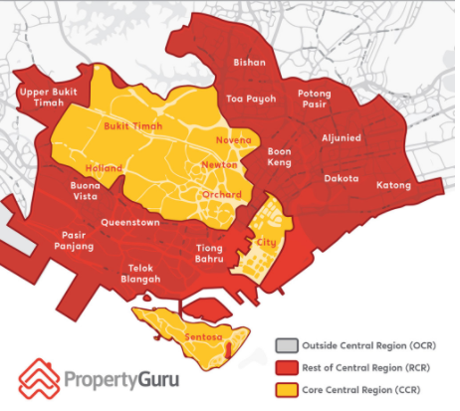
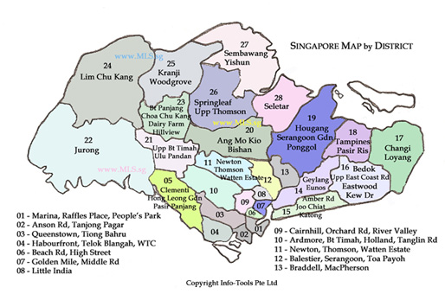
Which District has the cheapest non-landed Private Residential Property with the highest Rental Income?
Tan Siew Ling

Slide 2
Datasets used
Private Property Price Index of Non-landed Residential Properties by Locality, Quarterly
https://data.gov.sg/dataset/price-indices-of-non-landed-properties-by-locality
Non-Landed Private Property Rental Index by Type, Quarterly
https://data.gov.sg/dataset/rental-index-by-type-quarterly
Non-Landed Private Residential Property Resale Transaction
https://www.ura.gov.sg/realEstateIIWeb/transaction/search.action
Rental Contracts of Non-Landed Private Residential Properties
https://www.ura.gov.sg/realEstateIIWeb/transaction/search.action
List of Postal Districts (ura.gov.sg)
https://www.ura.gov.sg/realEstateIIWeb/resources/misc/list_of_postal_districts.htm

Slide 3
Scenario
Mary, a 50 year-old homemaker, has recently sold her Holland Road non-landed private property that she had co-owned with her husband for 2.1 millions.
With the sales proceeds, she plans to purchase 2 non-landed private property to obtain Rental income and Capital Gains to finance her 2 sons’ overseas education in 3 and 7 years time.

Slide 4
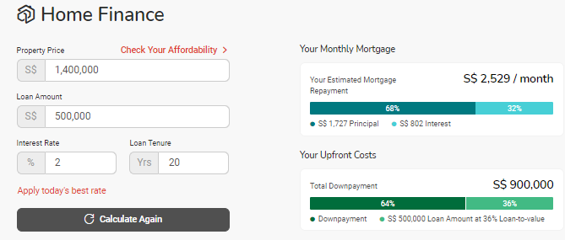
Scenario
She plans to keep $200K from the sale proceeds for her Older son’s overseas education
With 1.9 million left, she budgets $1 million for a 2-Bedroom unit for Rental Income and $900K for a 3-Bedroom unit for her family to stay.
She plans to finance the costs of the 3-Bedroom unit with a Bank Housing Loan of around $500K
Ideally, the rental income should
cover the monthly mortgage
repayment to prevent future
financial stress.

Slide 5
Scenario
She would like to find answers to the following questions :
Is it a good investment choice to invest in second condo unit for Capital Gains and Rental Income?
Which type of non-landed residential private property can she afford? 1,2,3-bedroom? In which districts?
Which of the selected districts command the highest rent?
Which Condominiums in the selected districts command the highest rent?

Slide 6
Scenario
To answer her questions, she will perform analysis on :
Private Residential Property Price Index
Private Residential Property Rental Index
Private Residential Property Median Prices by District, Floor Area
Private Residential Property Median Rental by District, Floor Area
Resale Transactions by Floor Area
Rental Contracts by Floor Area
Condominiums with Highest Rental

Slide 7
Dataset 1 - Private Property Price Index of Non-landed Residential Properties by Locality, Quarterly
Mary wonders if it is a good investment choice to invest in second condo unit for Capital Gains and Rental Income
She decides to plot the Historical Private Property Price index and Rental Index using the Dataset 1 and Dataset 2 to analyse the trend for the past 16 years using the available data.
To prevent the erosion of the property value due to reducing leasehold, she is only interested in buying Freehold property. So she will just analyse for Freehold properties

Slide 8
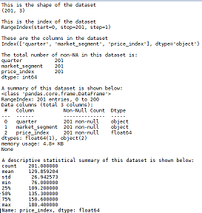
Dataset 1 - Private Property Price Index of Non-landed Residential Properties by Locality, Quarterly
Nature of Dataset

Slide 9
Dataset 1 - Private Property Price Index of Non-landed Residential Properties by Locality, Quarterly
Dataset 1 - Median Property Prices by District, Floor Area
Data Limitation
There is no Price Index for the whole of Singapore, only for the 3 Localities - Core Central Region(CCR), Rest of Central Region(RCR) and Outside Central Region(OCR)

Slide 10
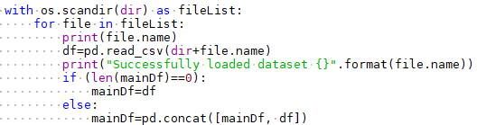


Dataset 1 - Private Property Price Index of Non-landed Residential Properties by Locality, Quarterly
Process and Outcome
To plot the Median Resale Price Index Line Chart:
Create 3 functions to extract data, process data and plot the graph
Load csv file
For each locality, Group Price index by year to get
Mean of the quarterly index
Plot Line Chart for each locality

Slide 11
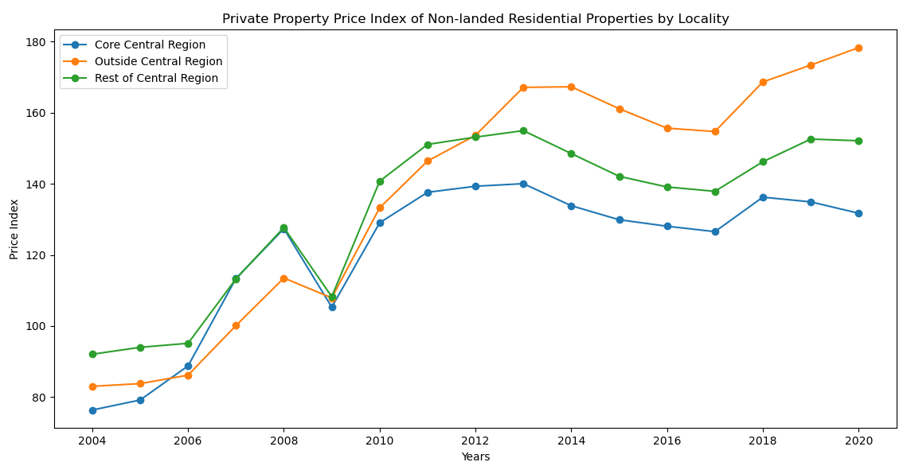
Dataset 1 - Private Property Price Index of Non-landed Residential Properties by Locality, Quarterly
Graphical Output - Line Chart

Slide 12
Dataset 1 - Private Property Price Index of Non-landed Residential Properties by Locality, Quarterly
Insights:
From the Line Chart,
We can see that the Non-landed Private Property prices had been mainly on an upward trend over the past 16 years with 2 dips in 2009 and 2017 due to the 2008-09 Global Financial Crisis, the 2015-2016 recession and the cooling measures adopted by Singapore Government respectively
Prices of properties Outside Central Region (OCR) has increased the most over the past 5 years, overtaking the other localities in 2012. This could be due to the high prices commanded by the central region properties which drove home-buyers and investors to the more attractively priced properties in OCR and Government’s plans to develop outside the central region.

Slide 13
Dataset 1 - Private Property Price Index of Non-landed Residential Properties by Locality, Quarterly
Conclusion/Recommendations:
Despite the pandemic in 2020, Singapore will continue to be a top investment destination and a safe haven for investors. Singapore's private residential market will remain attractive in the long term as historical data shows Singapore private residential property typically sees a quick rebound after each economic crisis.
So Singapore Property is still a good investment choice for long term.

Slide 14
Dataset 2 - Non-Landed Private Property Rental Index by Type, Quarterly
As Mary would like to have Rental Income, she will also plot the Historical Private Property Rental Index to analyse the rental market trend for the past 16 years using the available data

Slide 15
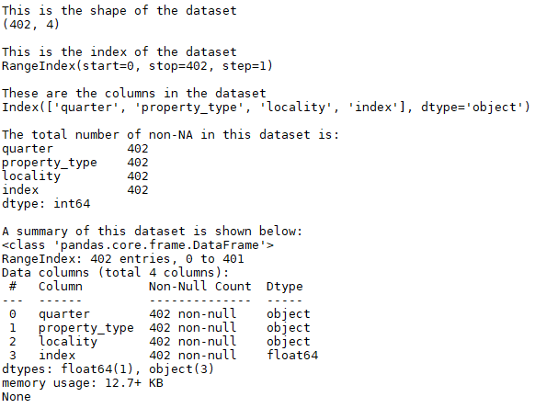
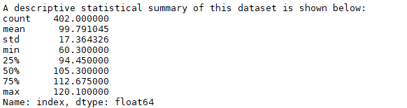
Dataset 2 - Non-Landed Private Property Rental Index by Type, Quarterly
Nature of Dataset

Slide 16
Dataset 2 - Non-Landed Private Property Rental Index by Type, Quarterly
Data Limitation
None

Slide 17

Dataset 2 - Non-Landed Private Property Rental Index by Type, Quarterly
Process and Outcome
To plot the Median Rental Index Line Chart:
Create 3 functions to extract data, process data and plot the graph
Load csv file
For each locality, Group Rental index by year to get
Mean of the quarterly index
Plot Line Chart for each locality

Slide 18
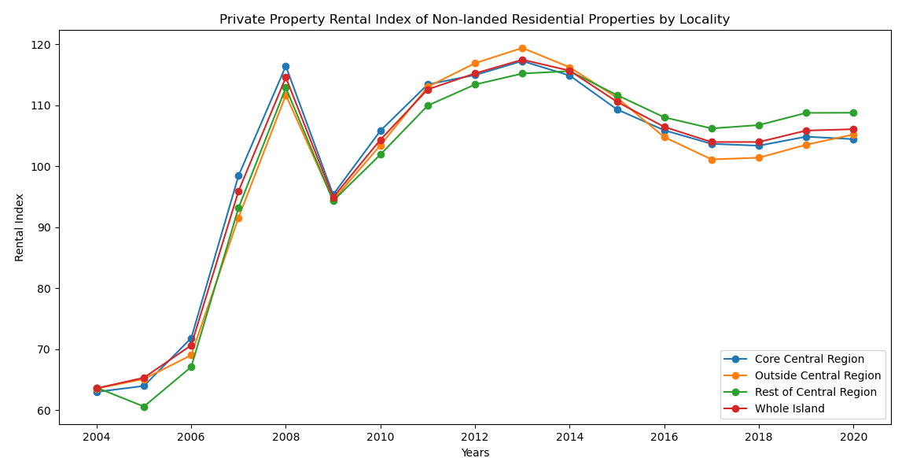
Dataset 2 - Non-Landed Private Property Rental Index by Type, Quarterly
Graphical Output - Line Chart

Slide 19
Dataset 2 - Non-Landed Private Property Rental Index by Type, Quarterly
Insights
From the Line Chart,
We can see that the Non-landed Private Rental prices had been mainly on an upward trend from 2004 until it dipped in 2009 due to the 2008-09 Global Financial Crisis. It dipped slightly again in 2017 due the 2015-2016 recession. It has since recovered slightly and is on the upward trend.
Rental of properties in the Rest of Central Region (RCR) has increased the most in recent years and have overtake rental in other parts of Singapore.
Even rental for properties Outside Central Region is starting to overtake the rental for properties in Core Central Region in 2020.

Slide 20
Dataset 2 - Non-Landed Private Property Rental Index by Type, Quarterly
Conclusion/Recommendations
Since Rental for Non-Landed Private Property is on an upward trend now, it is a good time to invest in a unit for rental income

Slide 21
Dataset 3 - Non-Landed Private Residential Property Resale Transaction
To find the size of property that she can afford, Mary decides to plot a Bar Chart for each size type (1,2,3 bedrooms), showing the Median Resale prices for the Top 10 districts with the lowest Average Median Resale Prices for the past 5 years using the available data

Slide 22
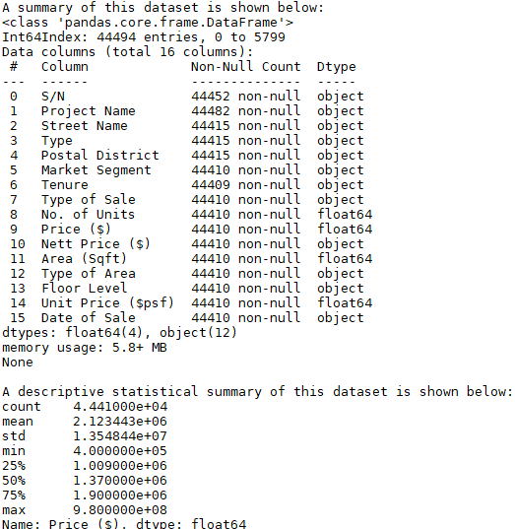
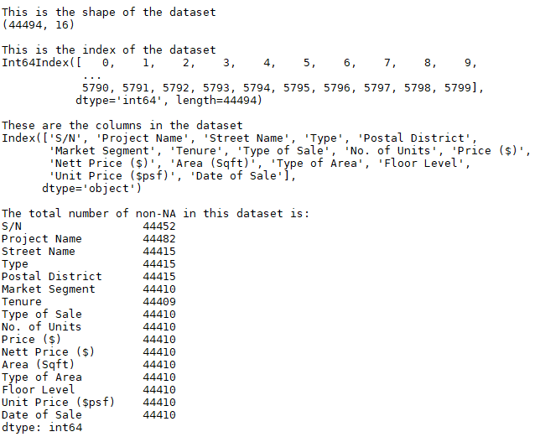
Dataset 3 - Non-Landed Private Residential Property Resale Transaction
Nature of Dataset:

Slide 23
Dataset 3 - Non-Landed Private Residential Property Resale Transaction
Dataset 3 - Private Residential Property Transaction
Data Limitation:
As the number of bedrooms for each resale transaction is not given, we have to use the floor size to estimate the number of bedrooms of each unit sold.
According to the website What condo size is right for you? - 99.co, to live in comfort, a person requires at least 250 sq ft of space. Hence, we will estimate the number of bedrooms using these floor areas.
Do note that there are some 2-bedroom units with a small floor area of 500 - 750 sqft and 3-bedroom units with floor area less than 1000 sq ft and large 1 bedroom units with more than 750 sqft.
No. of bedrooms | Floor Area
1 | 500 - 750
2 | 751 - 1000
3 | > 1000

Slide 24

Dataset 3 - Non-Landed Private Residential Property Resale Transaction
Process and Outcome
To plot the Top Cheapest Districts Bar Charts:
Create 3 functions to extract data, process data and plot the graph
Concat the multiple data csv files, load html files
Group Quarterly Resale Prices by Postal
Districts and year to get Median then get
the Mean of these for the past 5 years
and sort in ascending order
Plot Bar Chart for Top Cheapest district

Slide 25
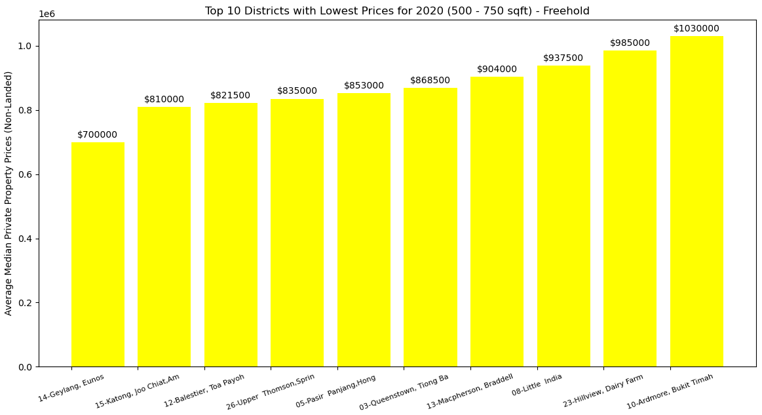
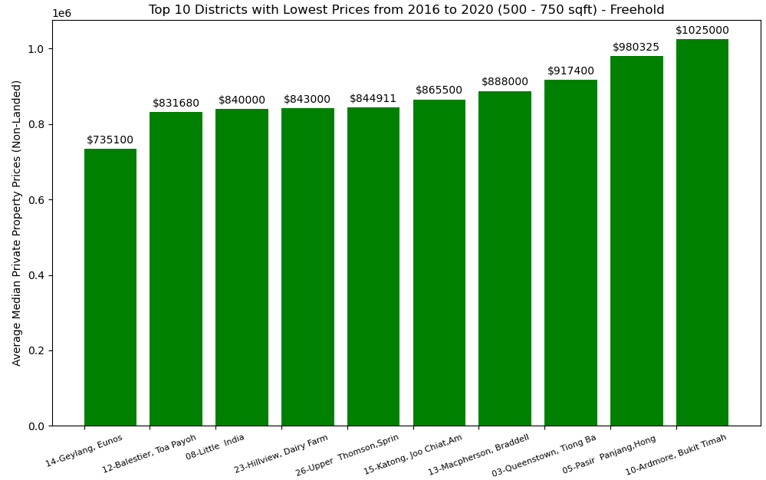
Dataset 3 - Non-Landed Private Residential Property Resale Transaction
Graphical Output - Bar Chart (1-bedroom)

Slide 26
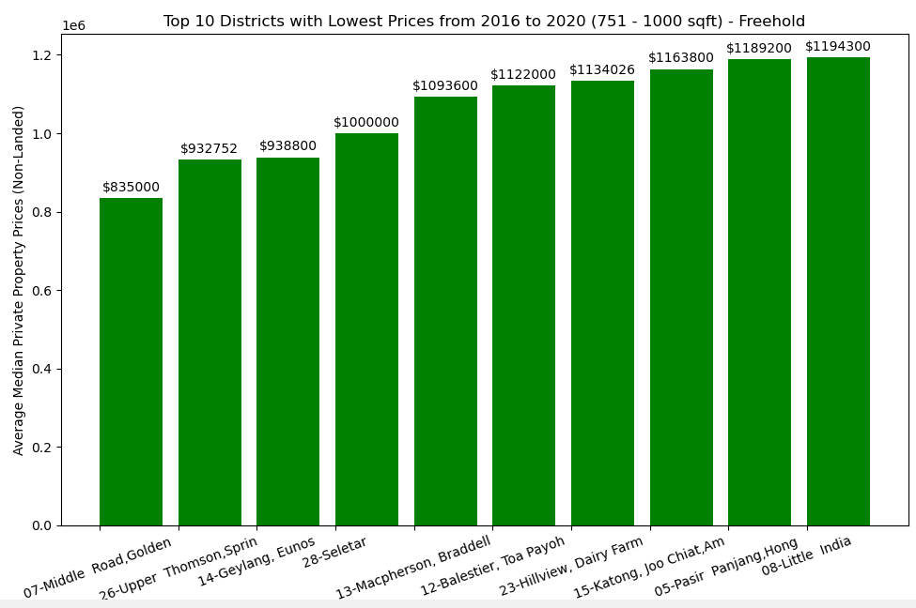
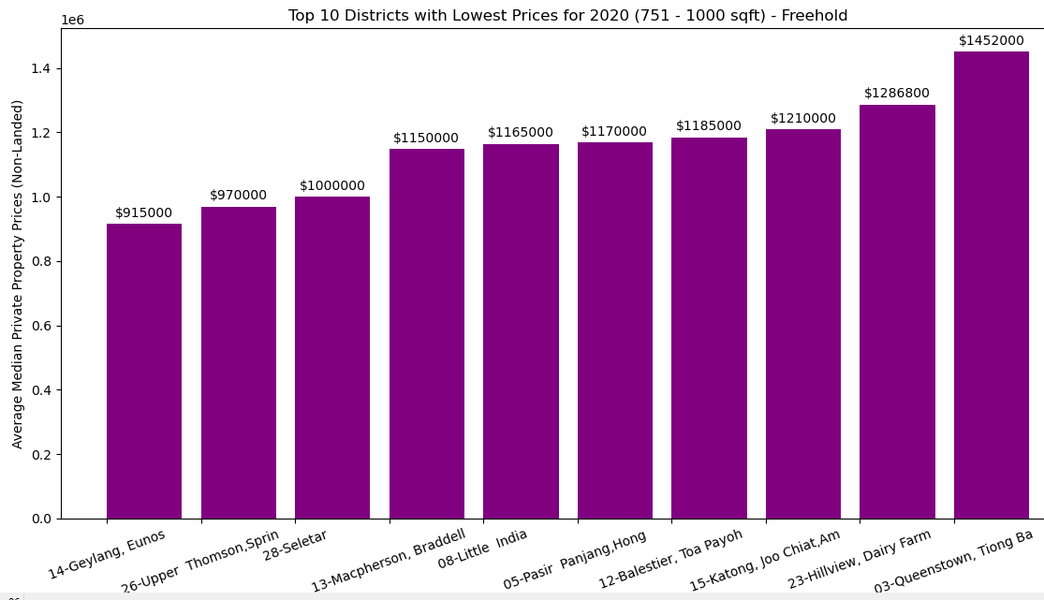
Dataset 3 - Non-Landed Private Residential Property Resale Transaction
Graphical Output - Bar Chart (2-bedroom)

Slide 27
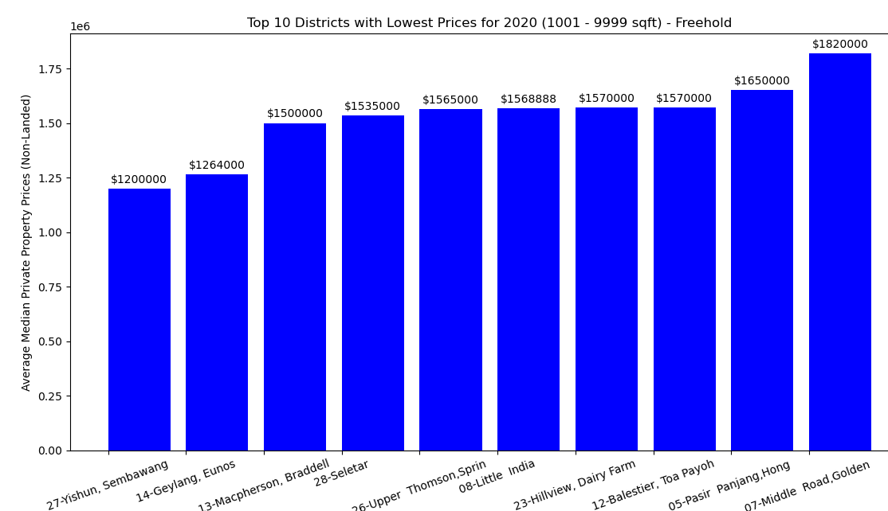
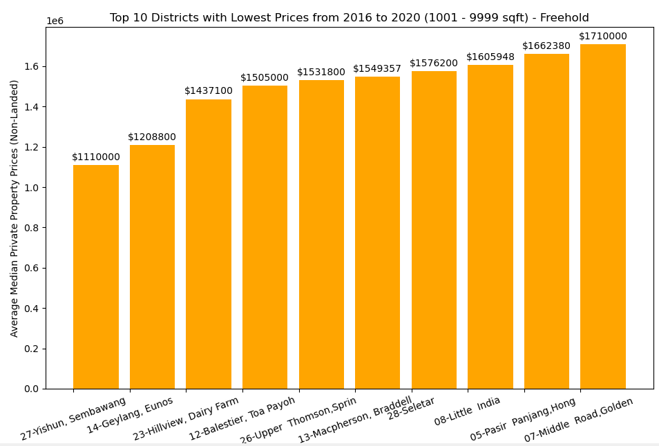
Dataset 3 - Non-Landed Private Residential Property Resale Transaction
Graphical Output - Bar Chart (3-bedroom)

Slide 28
Dataset 3 - Non-Landed Private Residential Property Resale Transaction
Insights
From the Bar Charts,
Since the property prices have been increasing over the years, it will be more accurate to look at the latest prices in 2020.
From the 2020 charts, Mary can see that she can afford to buy 1-bedroom units in most districts and 2-bedroom units in Geylang, Upper Thomson and Seletar district with her budget of 1 million for the investment unit.
For the 3-bedroom to stay, she can afford the units in Yishun/Sembawang and Geylang districts with her budget of 1.4million.

Slide 29
Dataset 3 - Non-Landed Private Residential Property Resale Transaction
Conclusion/Recommendations:
Mary can consider buying a 1-bedroom unit for investment gains and rental income as these are more affordable for her and she has more districts to choose from when buying such units.
However, she has concerns that such units may have low demand in the Resale and Rental market due to the limited pool of buyers and tenants who are Singles/Couples without kids, making it harder to rent out (lower rent) or sell it in future
She can buy a 2-bedroom unit in Geylang, Upper Thomson and Seletar districits but the rental and resale demand may be lower due to these locations not being centralised and Geylang’s bad reputation as a red-light district

Slide 30
Dataset 4 - Rental Contracts of Non-Landed Private Residential Properties
Since Mary plans to rent out the investment unit for rental income to help to repay her monthly mortgage installment, she needs to analyse the Median Rent for all the selected districts
She decides to plot a Bar Chart comparing the Median Rent for all the selected districts for year 2020 for 1-bedroom and 2-bedroom units.

Slide 31
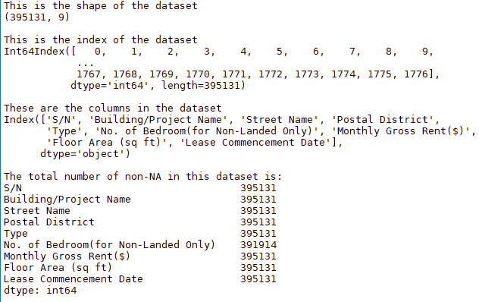
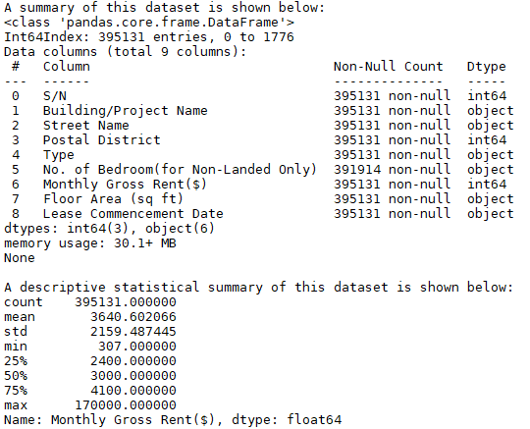
Dataset 4 - Rental Contracts of Non-Landed Private Residential Properties
Nature of Dataset

Slide 32
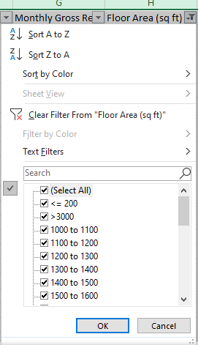
Dataset 4 - Rental Contracts of Non-Landed Private Residential Properties
Data Limitation
The Floor area of some units for rental is given as a range instead of a numeric number. We will assume the lower range as the floor area of the unit for rent
Although there is a Number of Bedroom column, but most of the data has NA value for this column. Hence, the dataset with valid value for this column may not be sufficient for analysis for some districts.
2 sets of Bar Charts are plotted for each bedroom type: one using the Number of Bedroom column and one using the floor area to see if there is any differences.

Slide 33

Dataset 4 - Rental Contracts of Non-Landed Private Residential Properties
Process and Outcome
To plot the Top Highest Rental Districts Bar Charts:
Create 3 functions to extract data, process data and plot the graph
Concat the multiple data csv files, load html file
Group Monthly Gross Rent by Postal
Districts and year to get Median then get
the Mean of these for the past 5 years.
and sort in descending order
Plot Bar Chart for Top Highest Rental districts

Slide 34
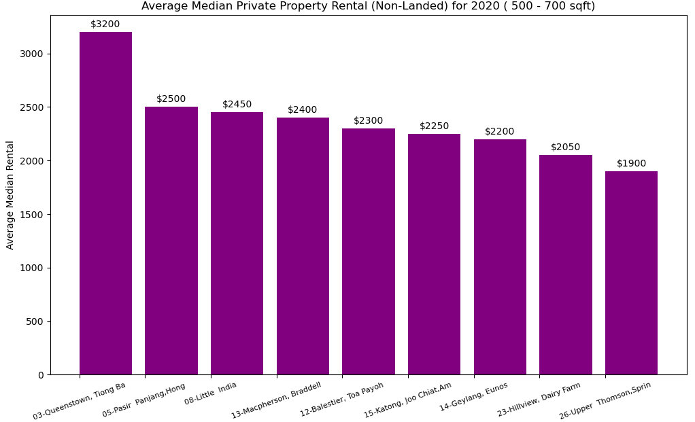
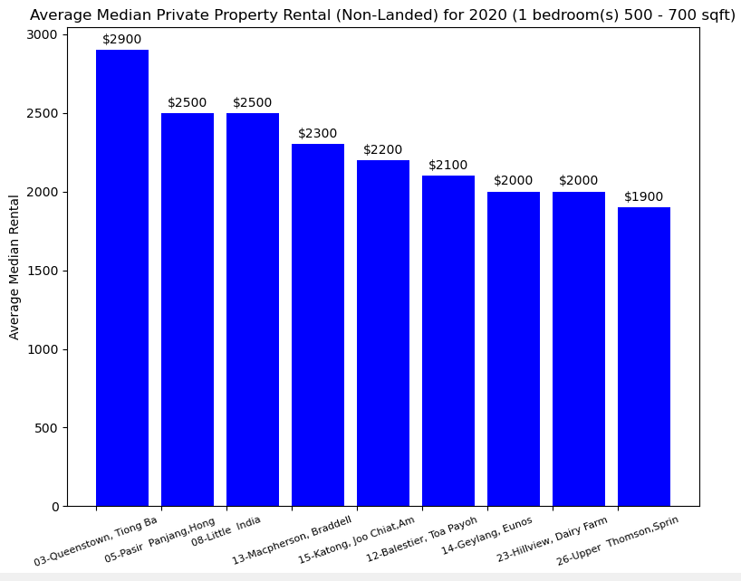
Dataset 4 - Rental Contracts of Non-Landed Private Residential Properties
Graphical Output - Bar Chart (1-bedroom)

Slide 35
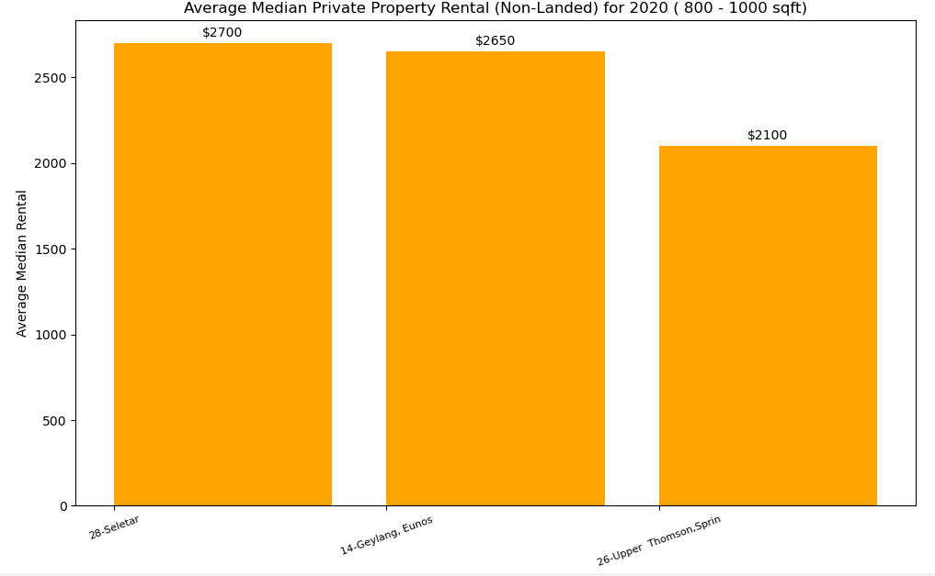
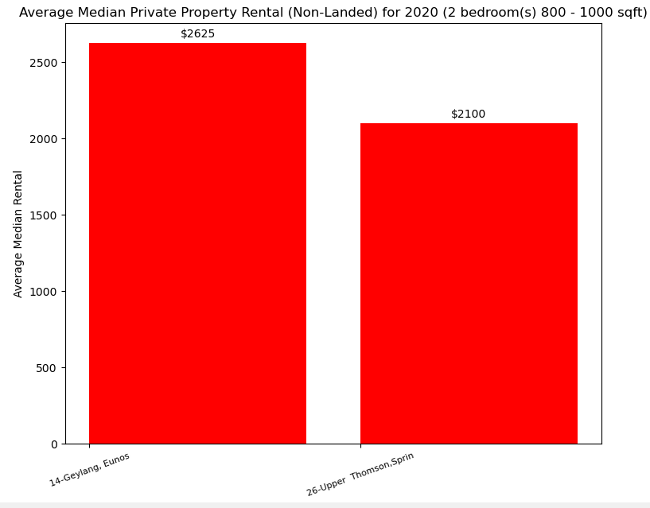
Dataset 4 - Rental Contracts of Non-Landed Private Residential Properties
Graphical Output - Bar Chart (2-bedroom)

Slide 36
Dataset 4 - Rental Contracts of Non-Landed Private Residential Properties
Insights
A 1-bedroom unit in a good and centralized location like Queenstown and Tiong Bahrun can command more rent than a 2-bedroom unit in non-centralized locations like Seletar and Upper Thomson.
Although Geylang is in a more central location, it’s reputation as the red-light district of Singapore has a great impact on its rental income and resale value. The pool of rental tenant will also include dubious characters.
A 1-bedroom unit in Queenstown, Tiong Bahru and Pasir Panjang districts or a 2-bedroom unit in Seletar and Geylang districts will generate a rental income sufficient to cover Mary’s monthly mortgage installments.

Slide 37
Dataset 4 - Rental Contracts of Non-Landed Private Residential Properties
Conclusion/Recommendations:
Mary can get a 1-bedroom unit in Queenstown, Tiong Bahru and Pasir Panjang districts or a 2-bedroom unit in Seletar and Geylang districts to generate a rental income sufficient to cover her monthly mortgage installments.

Slide 38
Dataset 3,4 - Resale Transaction and Rental Contracts of Non-Landed Private Residential Properties
As Mary is concerned that 1-bedroom units may have low demand in the Resale and Rental market, she decides to plot the Pie Chart to analyse the Rental and Resale transaction volume for each condo size type based on floor area

Slide 39
Dataset 3,4 - Resale Transaction and Rental Contracts of Non-Landed Private Residential Properties
Nature of Dataset : as mentioned in the previous slides
Data Limitation : as mentioned in the previous slides

Slide 40
Dataset 3,4 - Resale Transaction and Rental Contracts of Non-Landed Private Residential Properties
Process and Outcome
To plot the Resale and Rental Transaction Pie charts
Create 3 functions to extract data, process data and plot the graph
Concat the multiple data csv file
Filter by the minimum and maximum Floor size
And count the Resale/Rental transactions for year 2020
Plot Pie Charts

Slide 41
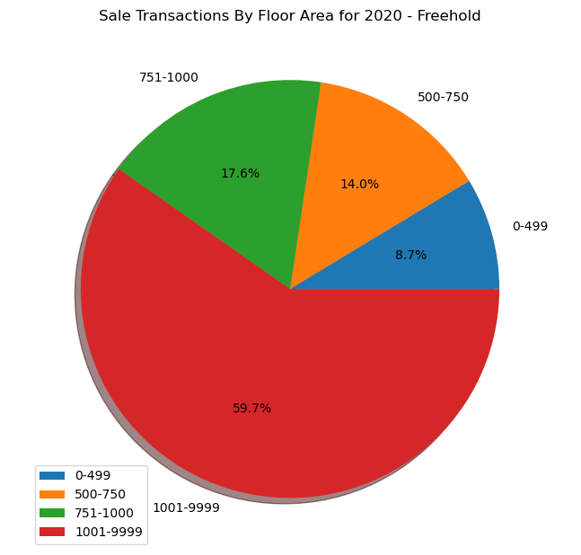
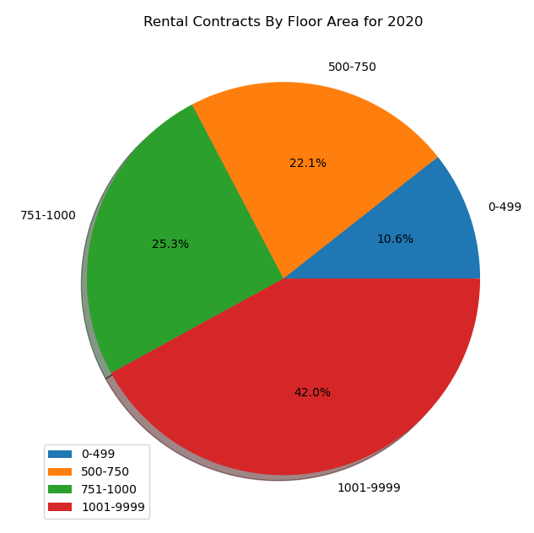
Dataset 3,4 - Resale Transaction and Rental Contracts of Non-Landed Private Residential Properties
Graphical Output - Pie Chart

Slide 42
Dataset 3,4 - Resale Transaction and Rental Contracts of Non-Landed Private Residential Properties
Insights
There is slightly more Resale and Rental demand for units of floor area 751 - 1000 sqft (2-bedroom) units (about 3% more) compared to units of floor area 500 - 750 sqft (1-bedroom) units
This could be due to the shrinking size of families in Singapore as a result of low birth rates and low marriage rate. Hence, there are comparable demand for the smaller 1-bedroom units

Slide 43
Dataset 3,4 - Resale Transaction and Rental Contracts of Non-Landed Private Residential Properties
Conclusion/Recommendations:
With declining Birth rates and Marriage rates, there will be growing demands for the smaller 1-bedroom units. This will help to address the Resale and Rental demands concerns that Mary has about investing in 1-bedroom units

Slide 44
Dataset 4 - Rental Contracts of Non-Landed Private Residential Properties
Mary would like to find out which Condos command the Highest Rental in the selected districts :
For 1 Bedroom - Queenstown,Tiong Bahru (03), Pasir Panjang (05)
For 2 Bedroom : Geylang (14), Seletar (28)
She decides to plot Box plots for the Top 10 cheapest Condos in each selected district

Slide 45
Dataset 4 - Rental Contracts of Non-Landed Private Residential Properties
Nature of Dataset : as mentioned in previous slides
Data Limitation : as mentioned in previous slides

Slide 46
Dataset 4 - Rental Contracts of Non-Landed Private Residential Properties
Process and Outcome
To plot the Top Highest Rental Districts Bar Charts:
Create 3 functions to extract data, process data and plot the graph
Concat the multiple data csv files, load the html file
Filter for selected District
Group by Project to get Median rent for project and
sort in descending order
Plot Box Plots

Slide 47
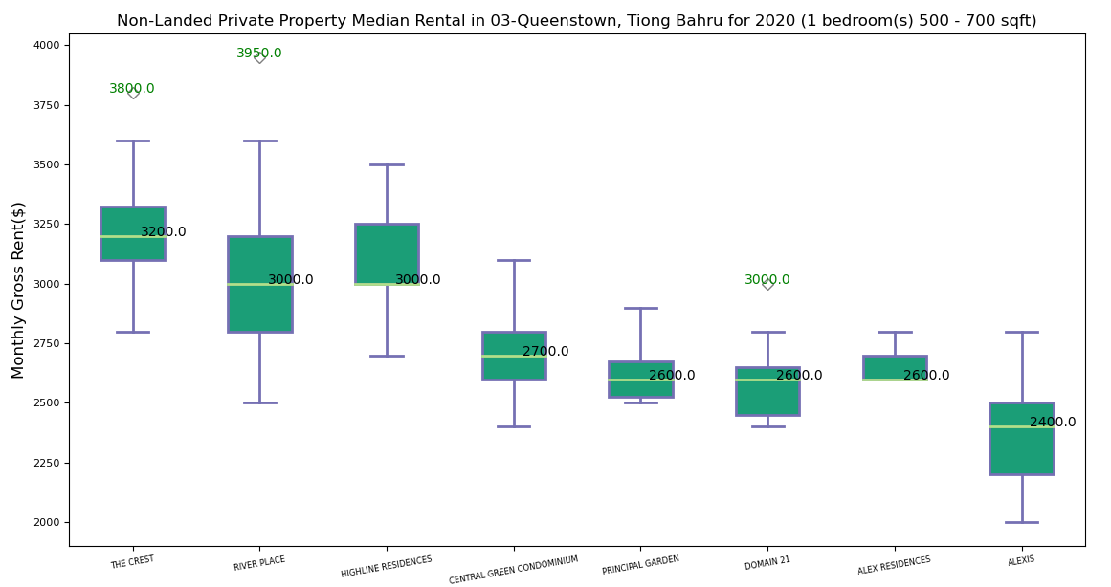
Dataset 4 - Rental Contracts of Non-Landed Private Residential Properties
Graphical Output - Box Plots - Queenstown, Tiong Bahru (03)

Slide 48
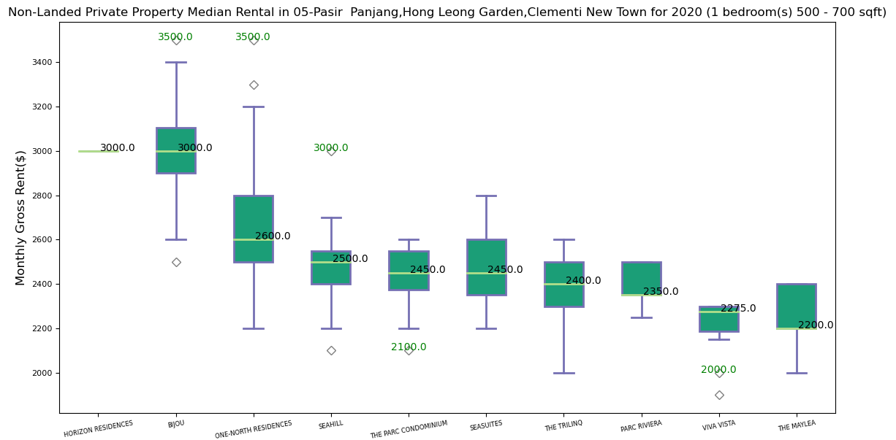
Dataset 4 - Rental Contracts of Non-Landed Private Residential Properties
Graphical Output - Box Plots - Pasir Panjang, Clementi (05)

Slide 49
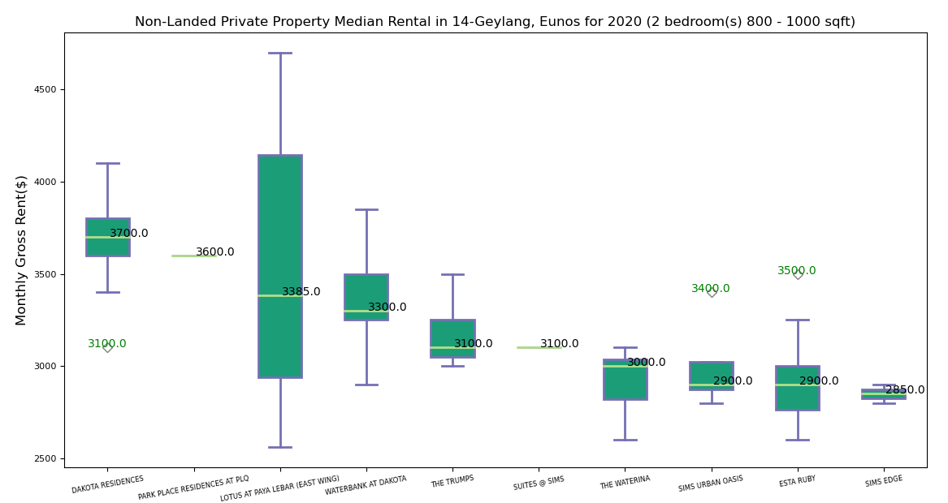
Dataset 4 - Rental Contracts of Non-Landed Private Residential Properties
Graphical Output - Box Plots - Geylang, Eunos (14)

Slide 50
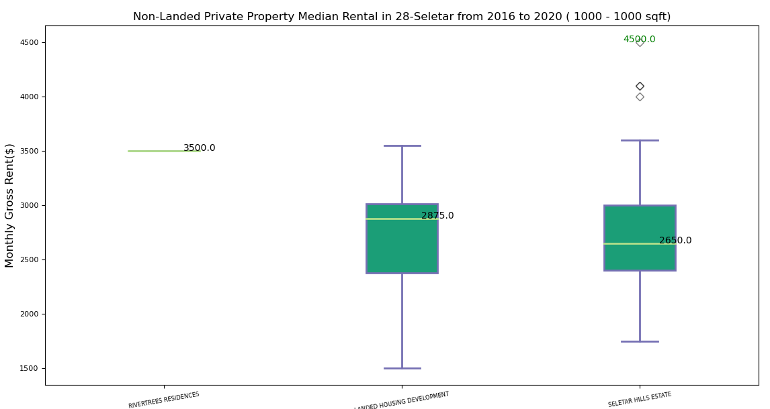
Dataset 4 - Rental Contracts of Non-Landed Private Residential Properties
Graphical Output - Box Plots - Seletar (28)

Slide 51
Dataset 4 - Rental Contracts of Non-Landed Private Residential Properties
Insights
In Queenstown, Tiong Bahru District:
All Top 7 condos give a median rental income that can cover Mary’s monthly mortgage installment of about $2.6K
The rentals at River Place condo has more variation ( larger IQR, less consistency) compared to the rest of the Condo which have less variation in rentals (smaller IQR, more consistency)
The Crest and River Place condos each has an outlier unit with extremely high rental
Rentals at Highline Residences and Alexis Residences are extremely right/positively skewed

Slide 52
Dataset 4 - Rental Contracts of Non-Landed Private Residential Properties
Insights
In Pasir Panjang District:
Horizon Residences has very few units for rental so there is no box shown in the box plot
Only Bjou and One-North Residences give a median rental income that can cover Mary’s monthly mortgage installment of about $2.6K
The rentals at One-North Residences condo has more variation ( larger IQR, less consistency) compared to the Bjou Condo which has less variation in rentals (smaller IQR, more consistency)
The Bjou and One-North Residences condos each has an outlier unit with extremely high rental and Bjou has one outlier unit with extremely low rent.

Slide 53
Dataset 4 - Rental Contracts of Non-Landed Private Residential Properties
Insights
In Geylang, Eunos:
All Top 10 condos give a median rental income that can cover Mary’s monthly mortgage installment of about $2.6K
Park Place Residences at PLQ has very few units for rental so there is no box shown in the box plot. This may be because it has just TOP in 2020.
Rentals at Lotus At Paya Lebar (East Wing) condo has the most variation ( larger IQR, less consistency) compared to the rest of the Condos which has less variation in rentals (smaller IQR, more consistency)
Rentals at at Lotus At Paya Lebar (East Wing) condo is also right/positively skewed.

Slide 54
Dataset 4 - Rental Contracts of Non-Landed Private Residential Properties
Insights
In Seletar:
There are very few condominiums in this district. There are mostly landed properties.The non-landed properties data contains landed properties
The rental units are around 1000 sqft.
Rivertree residences has very few units for rent so there is no box for its box plot
Rentals at Seletar Hills Estate is right/positively skewed and the Median Rental is sufficient to cover Mary’s monthly mortgage installment
There are a few outliers units at Seletar Hills Estate which commands high monthly rental

Slide 55
Dataset 4 - Rental Contracts of Non-Landed Private Residential Properties
Conclusion/Recommendations:
Mary can consider investing in a 1-bedroom unit in any of Top 3 Rentals condos in Queenstown, Tiong Bahru district, namely The Crest, River Place and Highline Residences
If she prefers to invest in a 2-bedroom unit, she can invest in a 2-bedroom unit in any of the Top 3 Rentals condos in Geylang, Eunos district, namely Dakota Residences, Lotus At Paya Lebar (East Wing), Waterbank at Dakota

Slide 56
Summary
Recommendations:
With her budget and her objective to achieve Capital Gains and Rental Income from her investment unit to cover her monthly mortgage installments of her 3-bedroom unit for stay, it is recommended that Mary :
get a 3-bedroom unit in Yishun, Sembawang district instead of Geylang because its bad reputation as a red-light district will impact its resale value and demand. It will also not be a conducive environment for her 2 sons.
Get a 1-bedroom unit in Queenstown, Tiong Bahru district. It’s central location will help to ensure good rental income and resale demand. With declining Birth rates and Marriage rates, demand for smaller 1-bedroom units will grow in future.

Slide 57
References
What condo size is right for you? - 99.co
Is Singapore Property Still A Good Investment Choice Long Term? (stuartchng.com)
How a deep recession could impact the property market in Singapore - 99.co
Reasons for the big drop in private property prices in Q3 2016 (99.co)
How Did Past Recessions Affect Housing and Stock Prices in Singapore? | PropertyGuru Singapore
Will Singapore’s Property Prices Continue Falling? (dollarsandsense.sg)
Commentary: Why Singapore's private residential market will remain attractive in the long term - CNA (channelnewsasia.com)

